Slide 1


ITM 440/540
03 - Physical Layer
Representing Bit Patterns using Signals
davids @ 2013

Slide 2
Readings in text
Forouzan: Part 2 Introduction
Forouzan: Chapter 3
Illustrations from text are included in these slides
davids @ 2013

Slide 3
Outline: data – signal - channel
Data is the information we want to send
Signals are physical, observable events we use to encode data.
Channel or Link is the logical and physical path used to send the signal.
davids @ 2013

Slide 4
Outline: Analog and Digital
The data to be transmitted can be either
  Analog or digital data
The signals used to represent the data can be either
  Analog or digital signals
davids @ 2013

Slide 5
Outline: Periodic analog signals
Terminology of sine waves
  Frequency
  Period
  Amplitude
  Phase
Terminology of periodic signals moving in a medium
  Propagation speed
  Wavelength (propagation speed x period)
davids @ 2013

Slide 6
Outline: Time Domain vs. Frequency Domain
We can represent a signal in either the time domain or the frequency domain
In the time domain, the x-axis represents time and the y-axis represents amplitude
In the frequency domain, the x-axis represents frequency and the y-axis represents amplitude.
davids @ 2013

Slide 7
Outline: Periodic analog signals
Sine waves are the building blocks of all analog signals
A composite analog signal is the weighted sum of sine waves
davids @ 2013

Slide 8
Outline: Composite Signals
Terminology of composite analog signals
  Periodic
  Aperiodic
  Bandwidth
davids @ 2013

Slide 9
Outline: Digital Signals
Terminology of digital signals
  Level
  Bit Rate
  Propagation speed
  Bit Length
davids @ 2013

Slide 10
Outline: Bandwidth
The digital signal we put onto the transmission medium behaves like a composite analog signal
The signals have a characteristic bandwidth
The channels in which signals travel also have a characteristic bandwidth
The channels are classified as :
  Baseband
  Broadband
davids @ 2013

Slide 11
Outline: Baseband vs. Broadband
Baseband transmission
  Keeps the signal in digital format.
  The signal contains all the frequencies from 0 to infinity.
  The channel must pass all these frequencies.
Broadband transmission
  Uses a baseband signal to modulate an analog carrier frequency.
  The resulting signal occupies a part of the frequency spectrum centered around the analog carrier frequency.
  The channel must pass this set of frequencies
davids @ 2013

Slide 12
Outline: Transmission Impairments
Transmission impairments
  Attenuation
  Distortion
  Noise
Units of measure (metrics) used to describe transmission impairments
  Attenuation - dB
  Noise - SNR
davids @ 2013

Slide 13
Outline: Data Rate Limits
Data Rate Limits:
How many bits per second can be signaled in a channel?
The answer may depend on these factors:
  The analog bandwidth of the channel
  The number of signal levels in the digital representation of the data
  The amount of noise in the channel
davids @ 2013

Slide 14
Outline: Data Rate Limits
Data Rate Limits: Information Theory:
Information Theory is the branch of telecommunications that tries to identify the maximum data rate that can be sent in a given channel
Two important findings of information theory are
  Nyquist - noiseless channel - bit rate limit
  Shannon - noisy channel - bit rate
davids @ 2013

Slide 15
Outline: Nyquist and Shannon
Nyquist
  Maximum bit rate in a noiseless channel is proportional to the analog bandwidth of the channel and to the log base 2 of the number of levels in the signal.
  The constant of proportionality is 2.
Shannon
  Maximum bit rate in a noisy channel is proportional to the analog bandwidth and the log base 2 of the sum of 1 plus the SNR of the channel.
davids @ 2013

Slide 16
Outline: Units of measure
Characteristic Units, abbreviation
Analog Bandwidth Hertz, Hz
Digital Bandwidth bits per second, b/s
Throughput bits per second, b/s
Delay (latency) seconds, s
  Propagation time seconds, s
  Transmission time seconds, s
  Queuing time seconds, s
  Processing time seconds, s
Bandwidth-Delay product bits*
*a measure of volume – digital bandwidth x delay
davids @ 2013

Slide 17
Outline: Bandwidth-Delay Product
Bandwidth-Delay product
  a characteristic of a channel or link
  a measure of the volume of bits that the channel can hold
  the product of digital bandwidth (bits/sec) and delay (sec)
davids @ 2013

Slide 18
Physical Layer
Physical layer is a logical layer
It translates the logical ones and zeros that represent the data to be sent into physical signals that are put onto the medium of the network
davids @ 2013

Slide 19
Data vs. Signals that represent data
Distinguish between data and signals
Data is the information that needs to be transmitted
Signals are the observable changes we impose on the medium in order to represent data
davids @ 2013

Slide 20
analog vs. digital
Analog information takes on a continuous range of values.
Digital information takes on a discrete set of values.
davids @ 2013

Slide 21
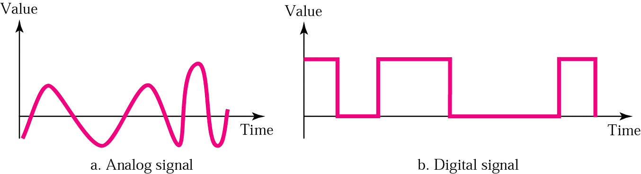
Analog signals and digital signals
Analog signal can take on a continuous set of values.
A digital signal can take on only a discrete set of values.
davids @ 2013

Slide 22
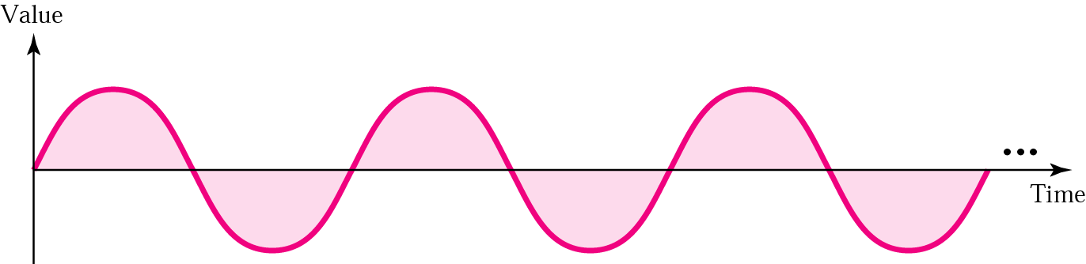
Analog Signals
The sine wave is the basic building block of all analog data
Any wave form can be represented by the sum of sine waves having different amplitudes, frequencies and phases
See the appendix to these slides and Section 3.2 of the text for more detail.
davids @ 2013

Slide 23
Digital signals
We now look at ways to represent data using a digital signal.
A digital signal can take on only discrete values - such as +5 volts and -5 volts, but not the voltages in between.
It is discontinuous.
davids @ 2013

Slide 24
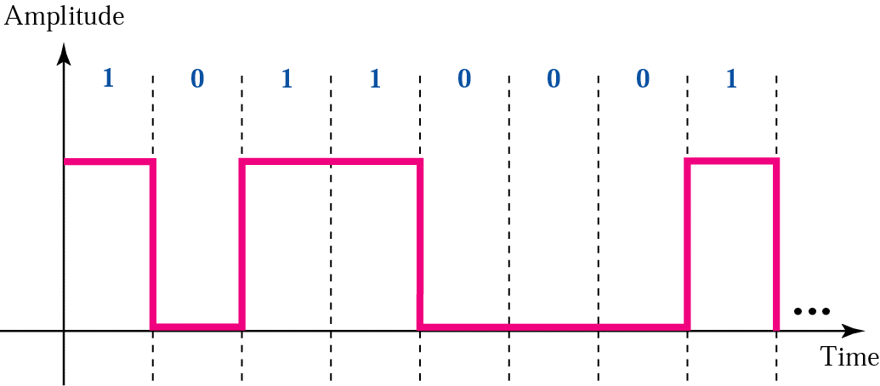
Digital signals
In illustration 3.16a below a positive voltage represents the bit ‘1’ and a zero voltage represents the bit ‘0’
The signal is discontinuous, since at the time T1, the signal appears to have two values +V and 0 simultaneously.
+V
0
T1
davids @ 2013

Slide 25
Digital signals
We can use a string of pulses to represent a digital signal.
In illustration 3.16 below a positive voltage represents the bit ‘1’ and a zero voltage represents the bit ‘0’
+V
0
T1
davids @ 2013

Slide 26

Digital signals
In illustration 3.16 b. below Level 4 represents the bit pattern 11, Level 3 represents the bit pattern 10, Level 1 represents the bit pattern 00.
davids @ 2013

Slide 27
Digital signals
Thus, in illustration 3.16 b. 2 bits are associated with each data level (data level == signal)
davids @ 2013

Slide 28
Digital signals
How many distinct data levels or signal levels do we need in this example?
4
davids @ 2013

Slide 29
Digital signals and Bit Length
To describe a digital signal we use a metric called ‘Bit Length.’
Bit Length is the distance that one bit occupies on the transmission medium.
It represents the speed of the signal on the transmission medium (distance/time) times the time period over which the signal is imposed on the medium (time)
(distance/time) x (time) == distance
davids @ 2013

Slide 30
Digital Signal is a composite analog signal
The very high frequencies contribute to the sharp edges.
The more harmonics you include, the more closely the wave can resemble an ideal square wave.
But the frequency spectrum of the medium over which you send the signal must include those high frequencies.
davids @ 2013

Slide 31
Digital Signals through different media
The higher the bandwidth of the medium, the more accurately the digital signal can be transported by that medium.
But, even band-limited media can carry digital signals.
For detail on analog signals see sections 3.1-3.2 of the text and also the appendix to these slides.
HW 3, Questions 1-4 rely on you knowing some of the terminology in these references.
davids @ 2013

Slide 32
Digital vs. Analog Bandwidth
Analog bandwidth is the range of frequencies that a medium can pass.
Digital bandwidth is the maximum bit rate that a medium can pass.
These two different measures of bandwidth use different units to represent the same property of the medium.
That property – intuitively – is ‘how fast the energy state of the medium can change.’
davids @ 2013

Slide 33
Baseband Transmission = Low Pass
When we use baseband transmission we send a digital signal over a channel without changing the digital signal into an analog signal
Baseband transmission requires we use a low band filter - a filter that allows frequencies as low as 0 Hz to pass.
davids @ 2013

Slide 34

Baseband Transmission requires a Low-Pass Channel
A low pass channel enable us to use baseband transmission methods.
These allow us to send a ‘frequency’ of 0 Hz
davids @ 2013

Slide 35
Baseband Transmission requires a Low-Pass Channel
Notice the low pass channel can have a wide bandwidth or a narrow bandwidth
The important thing is that it passes the 0 Hz frequency.
davids @ 2013

Slide 36
Low-pass vs. band-pass
Low pass has a low frequency of 0 and a high frequency of f.
Band-pass has a low frequency of f₁ and a high frequency of f₂, where f₁ is not equal to 0.
As you can see, a low pass link is a special case of a band-pass link.
davids @ 2013

Slide 37
Analog signals vs. digital signals
Digital signals need signals ranging in frequency form 0 to infinity.
But we don’t require infinitely high harmonics so we take f_{k}, where f_{k} is high enough to give us a pretty sharp edge on the square pulse.
Digital signals need a low pass link in order to create the flat top on the square pulse.
davids @ 2013

Slide 38
Analog signals vs. digital signals
Analog signals can occupy band-pass channels.
The bandwidth of an analog signal can be shifted. Thus if the signal has a low of f₁ and a high of f₂, it can be shifted to a low of f₁ +50 and a high of f₂ +50
Band-pass channels are more available than low-pass channels.
davids @ 2013

Slide 39
Analog signals vs. digital signals
Band-pass channels are more available than low-pass channels.
The bandwidth of a band-pass medium can be divided into several band-pass channels.
Each channel can then carry a different communication.
Example is analog cellular telephone network
Here 30 kHz channels are used.
davids @ 2013

Slide 40
Transmission Impairment
As a signal travels in a medium it gets damaged and altered in various ways.
Three basic types of impairments are:
  Attenuation
  Distortion
  Noise
davids @ 2013

Slide 41
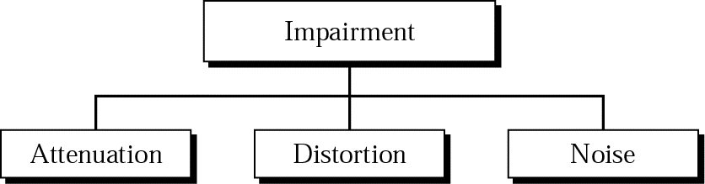
Transmission Impairment
As a signal travels in a medium it gets damaged and altered in various ways.
davids @ 2013

Slide 42
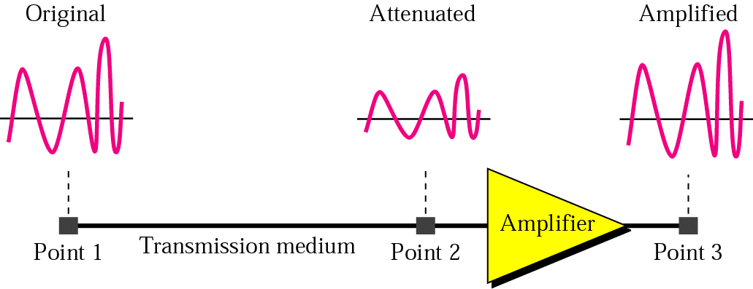
Attenuation
Attenuation refers to the loss of magnitude of the signal.
It refers to the loss of signal energy.
davids @ 2013

Slide 43
Attenuation
Attenuation is a relative measure
It’s unit is decibels - dB.
dB = 10log₁₀ (P2/P1) where P2 is the energy in the signal at point 2 and P1 is the energy in the signal at point 1
davids @ 2013

Slide 44
Example
Imagine a signal travels through a transmission medium and its power is reduced to half.
This means that P2 = 1/2 P1.
In this case, the attenuation (loss of power) can be calculated as
10 log₁₀ (P2/P1) = 10 log₁₀ (0.5P1/P1) =
10 log₁₀ (0.5) = 10(–0.3) = –3 dB
davids @ 2013

Slide 45
Example
Imagine a signal travels through an amplifier and its power is increased ten times.
This means that P2 = 10 P1. In this case, the amplification (gain of power) can be calculated as
10 log₁₀ (P2/P1) = 10 log₁₀ (10P1/P1)
= 10 log₁₀ (10) = 10 (1) = 10 dB
davids @ 2013

Slide 46
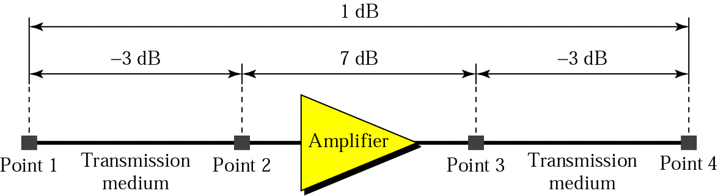
Example
dB is a useful metric since they can be added and subtracted whereas the numbers they represent would have to be multiplied and divided.
dB = –3 + 7 – 3 = +1
davids @ 2013

Slide 47
Distortion
Distortion refers to the fact that different frequencies within the composite signal’s frequency spectrum propagate through the medium at different speeds.
This means that different components of the waveform arrive at different times.
Adding them up at time t1 means that the signal that is recreated has a different shape than the one that was sent.
davids @ 2013

Slide 48

Distortion
Different components of the waveform arrive at different times, causing distortion at the receiver.
davids @ 2013

Slide 49
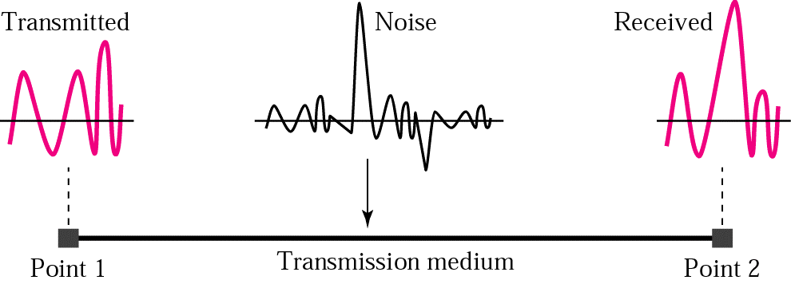
Noise
Noise refers to the presence of electromagnetic energy on the channel that was not put there by the data source.
davids @ 2013

Slide 50
Noise
This energy can come from several different sources:
  Thermal noise - random motion of electrons
  Induced noise - motors and appliances
  Cross talk - special case of induced noise
  Impulse noise - special case of induced noise resulting from
davids @ 2013

Slide 51
Noise
  Cross talk - special case of induced noise, where one wire acts as a broadcast antenna and the other as a receiver
  Impulse noise - special case of induced noise, where lighting or other electrical arcs occur over a very short period of time and dump a large spike of energy onto the channel
davids @ 2013

Slide 52

Noise
Cross talk and impulse noise are added to the information being carried in the cannel.
davids @ 2013

Slide 53
Noise Measurements
Two different metrics are used to quantify the amount of noise:
SNR = signal to noise ratio
SNR_{dB} = signal to noise ratio measured in dB
dB = 10log10 (P2/P1), where P2 is power in signal 2 and P1 is power in signal 1
davids @ 2013

Slide 54
Noise Measurements
In the case of noise measurements,
SNR_{dB} = 10log10 (Power in signal/Power in noise)
SNR = Power in signal/Power in noise
davids @ 2013

Slide 55
Limits on data rates
Information theory teaches us that there is an upper limit on the rate at which information can be sent in a channel
Nyquist (noiseless) channel upper limit - says the upper limit is dependent on the number of levels we choose to encode our data
Shannon (noisy) channel upper limit - says the upper limit is independent of the number of levels and is proportional to the log₂ or (1+SNR)
davids @ 2013

Slide 56
Nyquist (noiseless) Bit Rate
Nyquist (noiseless) channel upper limit - says the upper limit is dependent on the number of levels we choose to encode our data
The maximum theoretical bit rate the channel can support is two times the product of the analog bandwidth of the channel and the logarithm to the base 2 of the number of different levels you use to encode your data
Bit Rate_{maximum} = 2 x bandwidth x log₂L
davids @ 2013

Slide 57
Nyquist (noiseless) Bit Rate
Bit Rate_{maximum} = 2 x bandwidth x log₂L
See examples 3.34, 3.35 and 3.36 on pages 86 and 87
davids @ 2013

Slide 58
Shannon (noisy – sh!) Bit Rate
Shannon (noisy) channel upper limit
The upper limit on the bit rate that the link or channel can carry is independent of the number of levels
The upper limit is proportional to the log₂ of (1+SNR), where SNR is the ratio of the power in the signal to the power in the noise. (Signal to Noise Ratio)
davids @ 2013

Slide 59
Shannon (noisy – sh!) Bit Rate
Bit Rate_{maximum} = bandwidth x log₂(1 + SNR)
Here bandwidth is the analog bandwidth of the channel measured in Hz – and is a number you can look up
SNR is a unitless number – the ration of two energy values – and is a number you can look up
See examples 3.38, 3.39 and 3.40
davids @ 2013

Slide 60
Performance Metrics
Bandwidth – bits / second
Throughput – bits/second
Latency or delay
  Propagation time
  Transmission time
  Queuing time
  Processing time
Bandwidth-Delay product
davids @ 2013

Slide 61
Throughput
The throughput of a system is the measure of how fast data can pass through a system.
The system may consist of hubs, switches, routers, and the links that connect them.
The system may simply be a switch, hub or router.
The throughput is measured in bits/second
davids @ 2013

Slide 62
Throughput
Thus, the units of measure are the same as the digital bandwidth or of the bit rate, but the significance is somewhat different.
Bits/sec
davids @ 2013

Slide 63
Latency
Latency measures the total time it takes a message to be sent from source to destination – starting with its first bit and ending with its last bit.
Four factors contribute to latency:
  Propagation time
  Transmission time
  Queuing time
  Processing time
davids @ 2013

Slide 64
Propagation time
Propagation time is the time it takes a bit to travel from source to destination.
Distance / Propagation speed (dist/sec)
Propagation speed is the speed of electromagnetic energy in the medium
davids @ 2013

Slide 65
Transmission time
Transmission time is the time it takes a message to travel from source to destination.
Message size (bits) / Bandwidth (bits/sec)
davids @ 2013

Slide 66
Queuing time and Processing time
Queuing time is the amount of time that a device such as a switch or router allows the message to sit in a queue before processing it.
Processing time is the amount of time that a device such as a switch or router takes to process the message once it is taken off the queue.
davids @ 2013

Slide 67
Bandwidth-Delay product
The bandwidth-delay product is a measure of the total number of bits the transmission link can hold.
Bandwidth (bits/sec) x Delay (sec)
davids @ 2013

Slide 68

Bandwidth-Delay Product
The bandwidth-delay product gives a measure of the number of bits that can occupy the link or channel at a given time.
davids @ 2013

Slide 69

Bandwidth-Delay Product
Figure 3.33 in Example 3.48 illustrates how the bandwidth-delay product corresponds to the volume of bits that can occupy the link at any time.
davids @ 2013

Slide 70
Appendix 1
Analog signals and their representation using sine waves
davids @ 2013

Slide 71
Analog Signals
Time Domain vs. Frequency Domain
Three attributes define a sine wave
  Amplitude
  Frequency
  Phase
davids @ 2013

Slide 72
Sine waves
A sine wave can be represented in the time domain by the formula:
s(t) = A sin(2π f t + φ )
s(t) is the height of the sine wave at time t
A is the maximum value of the sine wave
f is the frequency of the wave in cycles per second
φ is the phase of the wave
davids @ 2013

Slide 73
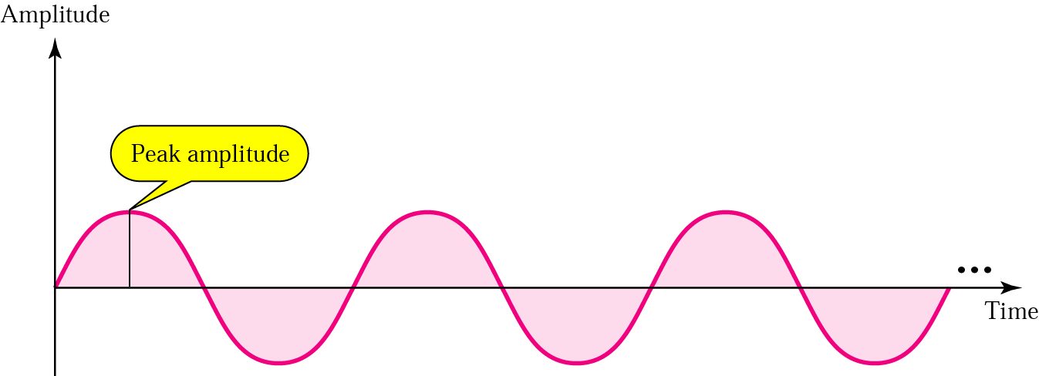
Amplitude
A sine wave takes on a continuous set of values between -A and +A.
davids @ 2013

Slide 74
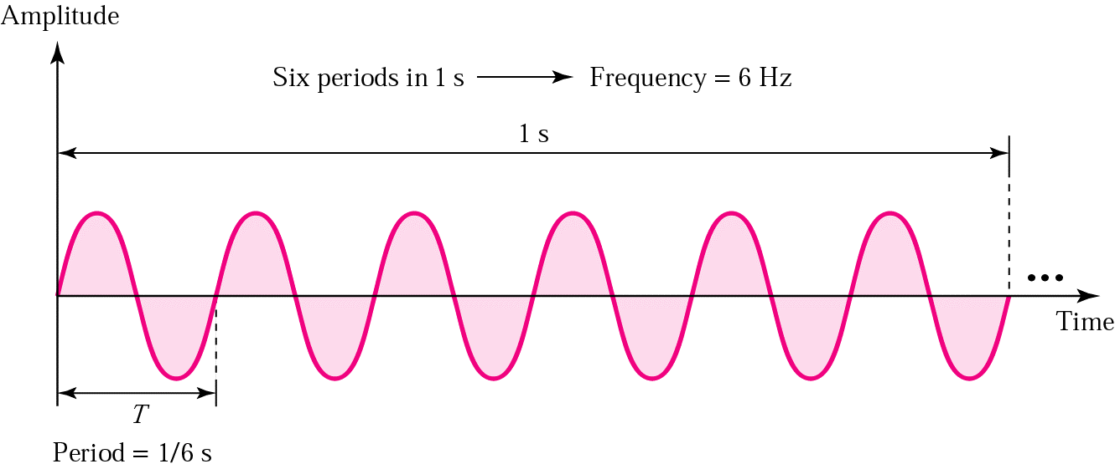
Frequency
The number of cycles per second.
A cycle is a single traversal of the recurring pattern.
davids @ 2013

Slide 75
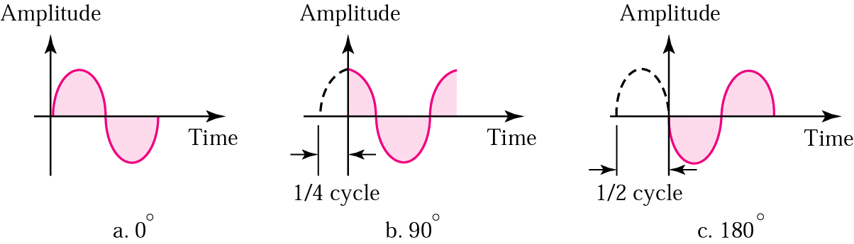
Phase
Defines the position of the wave pattern with respect to time 0.
davids @ 2013

Slide 76
Frequency vs. Period
Period is measured in seconds.
Frequency is measured in cycles per second or radians per second.
The name of the unit that measures cycles per second is Hertz, abbreviated Hz
davids @ 2013

Slide 77
Units of Period
Milliseconds 10⁻³ s
Microseconds 10⁻⁶ s
Nanoseconds 10⁻⁹ s
Picoseconds 10⁻¹² s
  From Table 3.1 page 61
  Memorize this terminology
davids @ 2013

Slide 78
Units of Frequency
Kilohertz 10³ Hz
Megahertz 10⁶ Hz
Gigahertz 10⁹ Hz
Terahertz 10¹² Hz
  Information in Table 3.1 page 61
  Memorize this terminology
davids @ 2013

Slide 79
Example
What is the frequency of a sine wave whose period is 100 ms?
Frequency = 1/period
Period = 100 ms = 100 x 10⁻³ s = 10² x 10⁻³ s = 10⁻¹ s
Frequency = 1/period = 1/10⁻¹ Hz = 10 Hz
Do you want this expressed in KHz?
  Substitute 1 Hz = 10⁻³ KHz into the above
  Frequency = 10 x 10⁻³ KHz = 10⁻² KHz
davids @ 2013

Slide 80
Generalizing Frequency
Frequency can be taken to mean the rate of change of a value with respect to time.
High frequency --> many changes in a given period of time
Low frequency --> few changes in the same period of time
davids @ 2013

Slide 81
Generalizing Frequency
Frequency of 0 -->constant signal level
Frequency of infinity -->signal level changes instantaneously (the change takes no time at all)
davids @ 2013

Slide 82
Phase
Phase corresponds to the position of the point on the circle when you started it rolling.
It represents the shift of the sine wave along the time axis.
davids @ 2013

Slide 83
Time Domain vs. Frequency Domain
The representations we have looked at so far are Time Domain representations of a sine wave
Time Domain representation shows how the amplitude of the wave changes with time
Using a time domain representation we can derive both the frequency and the phase of the wave
davids @ 2013

Slide 84
Time Domain vs. Frequency Domain
There is another way to represent a sine wave
A frequency domain representation
The frequency domain representation shows peak amplitude at each frequency
davids @ 2013

Slide 85
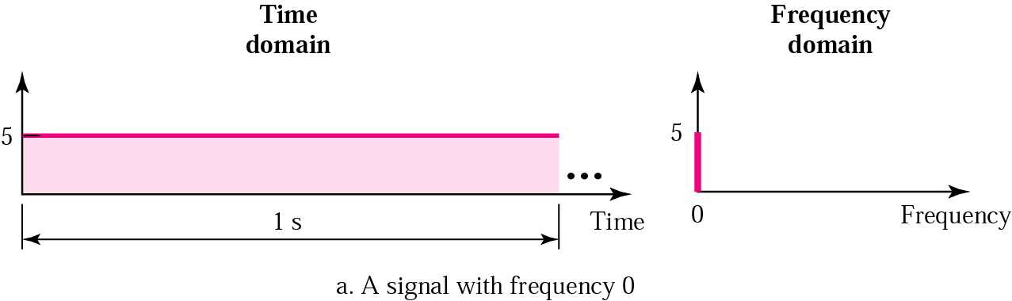
Example
This is a special case, with frequency 0.
A = 5
davids @ 2013

Slide 86
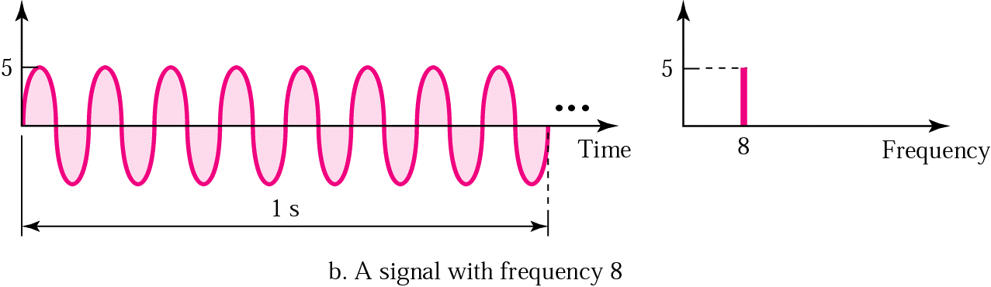
Example
f = 8
A = 5
davids @ 2013

Slide 87
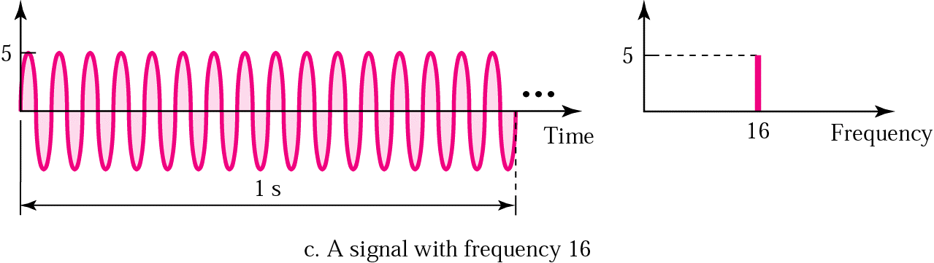
Example
f = 16
A = 5
davids @ 2013

Slide 88
Creating signals
To put a signal onto a medium we put electromagnetic energy onto the medium according to the specifications of our layer 1 protocol.
Doing this creates a complex wave on the medium.
That wave can be represented in the frequency domain by different amplitudes of different frequencies.
davids @ 2013

Slide 89
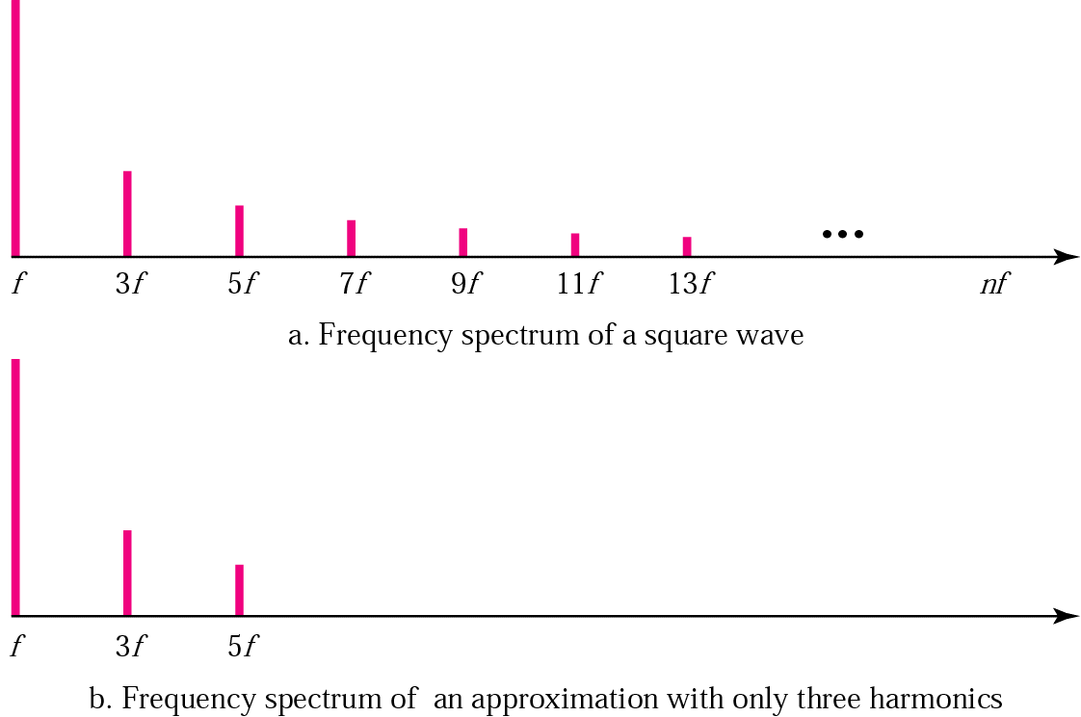
Frequency Spectrum of Composite Wave
davids @ 2013

Slide 90
Analyzing the signal
The signal can be represented by a weighted sum of sine waves of different frequencies. (Fourier analysis)
S(t) = A₁sin(2πf₁t + φ₁) + A₂sin(2πf₂t + φ₂) +
A₃sin(2πf₃t + φ₃) + A₄sin(2πf₄t + φ₄) + …
A_{n}sin(2πf_{n}t + φ_{n}) + A_{n+1}sin(2πf_{n+1}t + φ_{n+1}) + …..
davids @ 2013

Slide 91
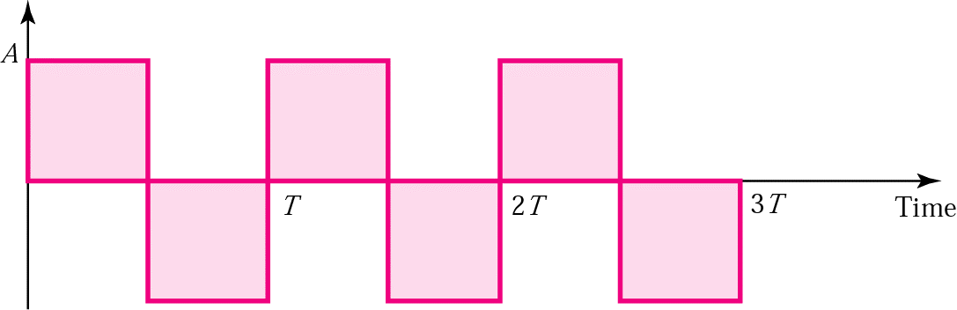
Example of a square wave
Below is an illustration (from ed. 3) of a square wave.
This is a periodic signal and is not useful for carrying information. It is used as illustration.
The period is time T.
davids @ 2013

Slide 92
Square wave example
This signal can be described by the following formula:
S(t) = 4A/π sin 2π(f)t + 4A/3π sin 2π(3f)t +
4A/5π sin 2π(5f)t + 4A/7π sin 2π(7f)t + ……….
davids @ 2013

Slide 93
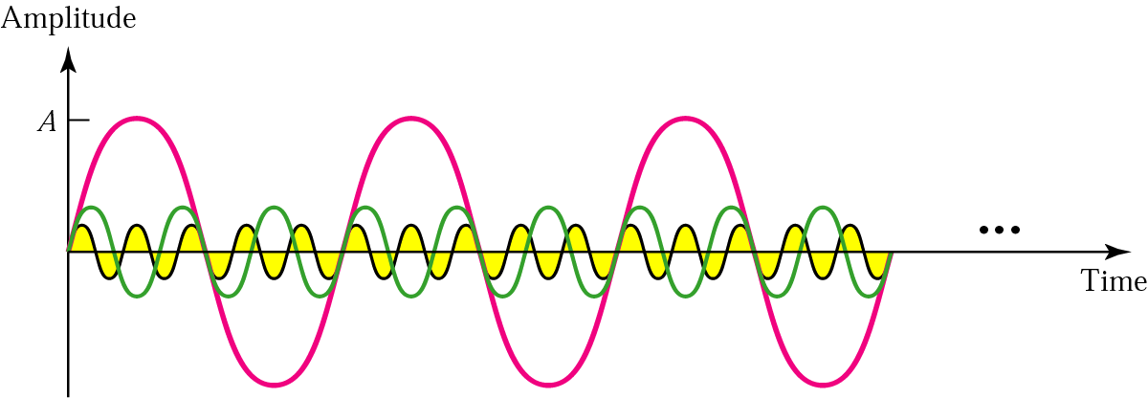
Square wave example
First three harmonics
Illustration from ed. 3
f
3f
5f
davids @ 2013

Slide 94
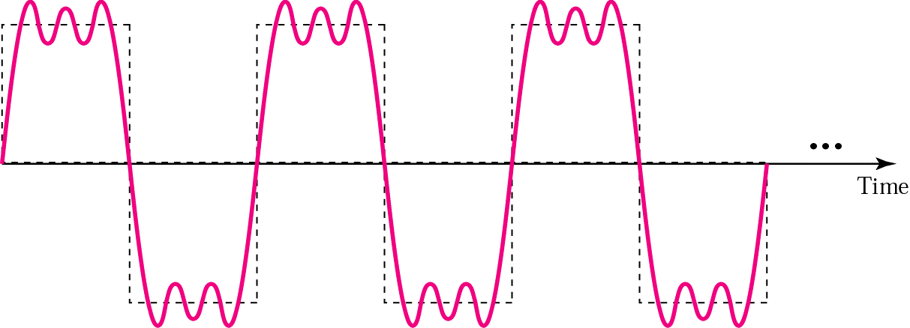
Square wave example
Sum of first three harmonics would look something like the illustration below.
davids @ 2013

Slide 95
Periodic vs. non-periodic
Interesting signals are non-periodic – that is – not predictable
Periodic signals can be represented in the frequency domain by a discrete set of frequencies
Non-periodic signals can be represented in the frequency domain by a continuous set of frequencies.
davids @ 2013

Slide 96

Periodic vs. non-periodic
Figure 3.12, ed. 4
davids @ 2013

Slide 97
Bandwidth of a Signal
The bandwidth of a signal refers to the difference between the highest significant* frequency and the lowest significant frequency in the signals frequency spectrum.
(*Significant - means that the frequency has a large enough amplitude to impact the results we are interested in.)
davids @ 2013

Slide 98
Bandwidth of a Channel
The bandwidth of a particular channel is the range of frequencies that it can pass without losing one-half of the power contained in the signal.
The bandwidth of a channel is given as the difference between two frequencies.
davids @ 2013

Slide 99
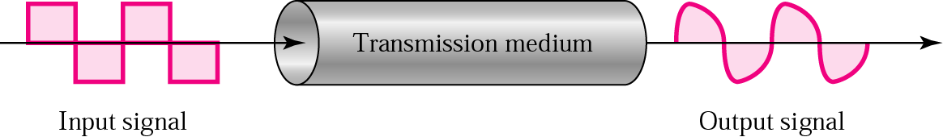
Signals on the medium
If the bandwidth of the signal includes spikes that fall outside the bandwidth of the medium, then the signal will degrade during transmission over that medium.
davids @ 2013

Slide 100
Example
If a periodic signal is decomposed into five sine waves with frequencies of 100, 300, 500, 700, and 900 Hz, what is the bandwidth?
Draw the spectrum, assuming all components have a maximum amplitude of 10 V.
davids @ 2013

Slide 101
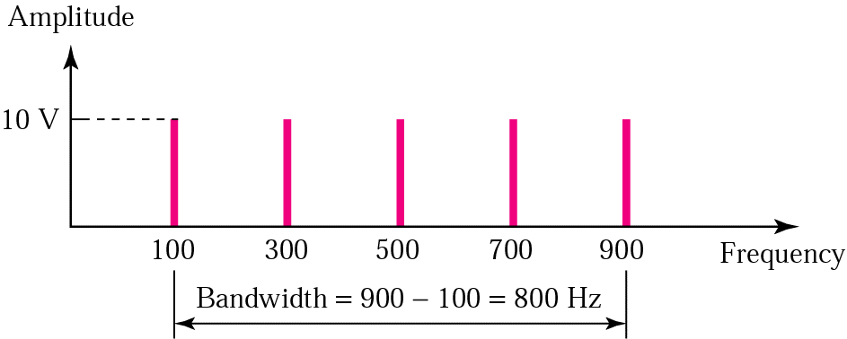
Solution
B = f_{h} - f_{l} = 900 - 100 = 800 Hz
The spectrum has only five spikes, at 100, 300, 500, 700, and 900
davids @ 2013

Slide 102
Example
A signal has a bandwidth of 20 Hz. The highest frequency is 60 Hz. What is the lowest frequency?
Draw the spectrum if the signal contains all integral frequencies of the same amplitude.
davids @ 2013

Slide 103
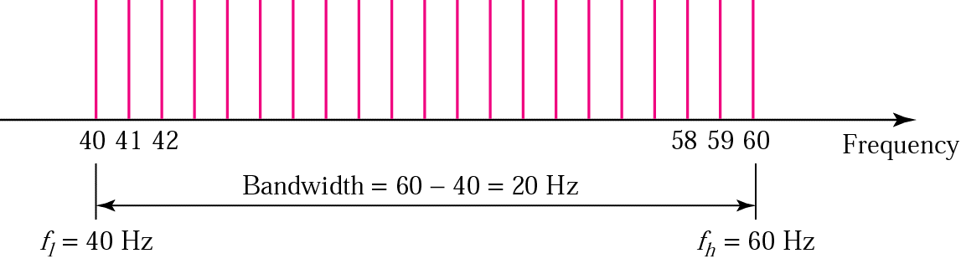
Solution
B = f_{h} - f_{l}
20 = 60 - f_{l}
f_{l} = 60 - 20 = 40 Hz
davids @ 2013

Slide 104
Bandwidth of medium vs. frequency spectrum of signal
If the highest frequency in the signal is 2 kHz and the lowest frequency in the signal is 1 kHz. This means that the bandwidth of the signal is 1 kHz (2-1).
Can you send that signal on the medium described on the next page?
davids @ 2013

Slide 105
Bandwidth of medium vs. frequency spectrum of signal
The highest frequency the medium can pass is 4 kHz and the lowest frequency the medium can pass is 3 kHz.
Thus, the bandwidth of the medium is 1 kHz (4-3).
But the medium can’t carry the signal because the two frequencies in the signal are 1 kHz and 2 kHz. They are both below the frequencies that the medium can pass.
davids @ 2013

Slide 106
The End
davids @ 2013

